Slide 1

Team no: 9
1) Sanjay.S.S - 2010103593
Phone - 9840251845
Email ID - sanjaysan01@gmail.com
2) Balaji.S - 2010103563
Phone - 9094676637
Email ID - balajisrinivas12@gmail.com

Slide 2

Given a Text image consisting of one word, recognize the characters of the image, extract them, form the word and then check for the spelling of the word. The result should say whether the word’s spelling is correct or not.

Slide 3

What is OCR?
Optical Character Recognition, usually abbreviated to OCR, is the mechanical or electronic conversion of scanned images of handwritten, typewritten or printed text. It is a common method of digitizing printed texts so that they can be electronically searched, stored more compactly, displayed online, and used in machine learning processes such as machine translation, text-to-speech and text mining. OCR is a field of research in Pattern Recognition, AI and Computer Vision.

Slide 4

The main aim of the system is to check for the spelling of a word in an image. To accomplish this, the system extracts the text from the image and then check for its spelling. If the word is spelled correctly, the result displayed will be “Correct” else “Wrong” will be displayed.

Slide 5

OCR is used in the field of Artificial Intelligence and Computer Vision.
OCR software works with Scanners to convert printed characters into digital text, allowing to search for or edit your document in a word processing program.
As a human being, it is easy to read out good quality text images and judge the correctness of the spelling easily.
But to make a computer do the same is very difficult.
The method of extracting text from an image is difficult and involves extensive Pattern Matching, Boundary Selection and Character Segmentation.

Slide 6

Design of an Optical Character Recognition System for Camera based Handheld Device
  Presents an OCR system for camera captured image/graphics embedded textual documents for handheld devices [1].
An Introduction to the Process of Optical Character Recognition
  Presents overview and techniques used for feature extraction that helps in efficient classification of alphabets and numbers of the English Language [2].
Machine-Printed and hand-written text lines identification.
  Identify Machine printed and handwritten text of Bangla and Devanagari scripts and classify them as either Machine printed or Hand written [3].

Slide 7

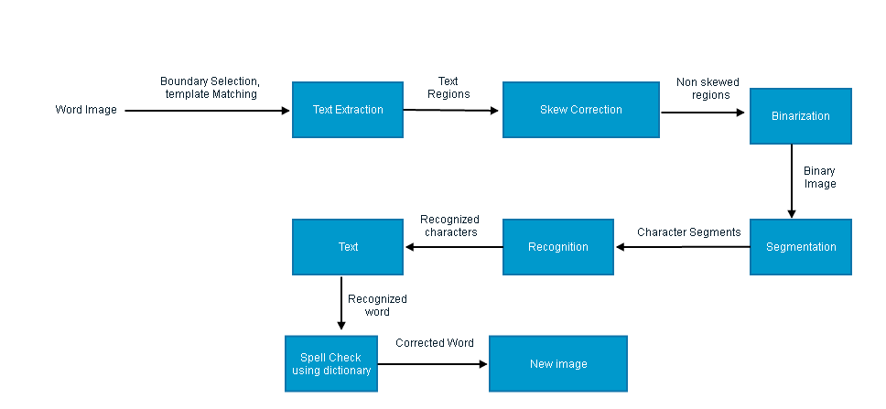

Slide 8
Module Description
Text Region Extraction Module: The colour image is converted into a grayscale image by converting the (R,G,B) values in each pixel into a grayscale pixel by applying the transformation: f(x,y) = 0.299 x 𝑟(𝑥,𝑦) +0.587 x 𝑔(𝑥,𝑦)+0.114 x b(x,y).
Skew Correction Module: Camera captured images often suffer from skew and perspective distortion due to unparallel axes and/or planes at the time of capturing the image. So, these text regions are de-skewed using a computationally efficient and fast skew correction technique.
Binarization Module: Binarization is the process of converting gray image into black-white image. A skew corrected text region is binarized using a improved version of Bernsen’s binarization method.

Slide 9
Text Segmentation Module: After binarizing a text region, the horizontal histogram profile {𝑓𝑖,𝑖 = 1,2, . . ,𝐻𝑅} of the region is analyzed for segmenting the region into text lines. Using vertical histogram profile of each individual text lines, words and characters are segmented.
Character Recognition Module: This is the main algorithm of OCR; an image of every character must be converted to appropriate character code. The sequential steps required to classify an individual binarized character are
  Boundary Selection
  Normalization
  Template Matching
  Character Recognition
Spell Checker Module: In this module , the recognized word is taken and checked against a open-source dictionary. If the spelling is right, the user will get a popup box with the word unchanged. But if it is wrong, then we get a popup box with the word underlined in red to indicate a mistake.

Slide 10

This project is evaluated by the accuracy of character and word recognition
The accuracy is calculated by the ratio of the number of words correctly identified to the number of words sampled
The number of words wrongly identified can also be identified by the number of words wrongly recognised

Slide 11

[1] Ayatullah Faruk Mollah, Nabamita Majumder, Subhadip Basu and Mita Nasipuri,” Design of an Optical Character Recognition System for Camera based Handheld Device”, 2011.
[2] Umal Patel,”An Introduction to the Process of Optical Character Recognition”, 2013.
[3] U.Pasl, B.B. Chaudhuri,”Machine-printed and hand-written text lines Identification.

